Slide 1
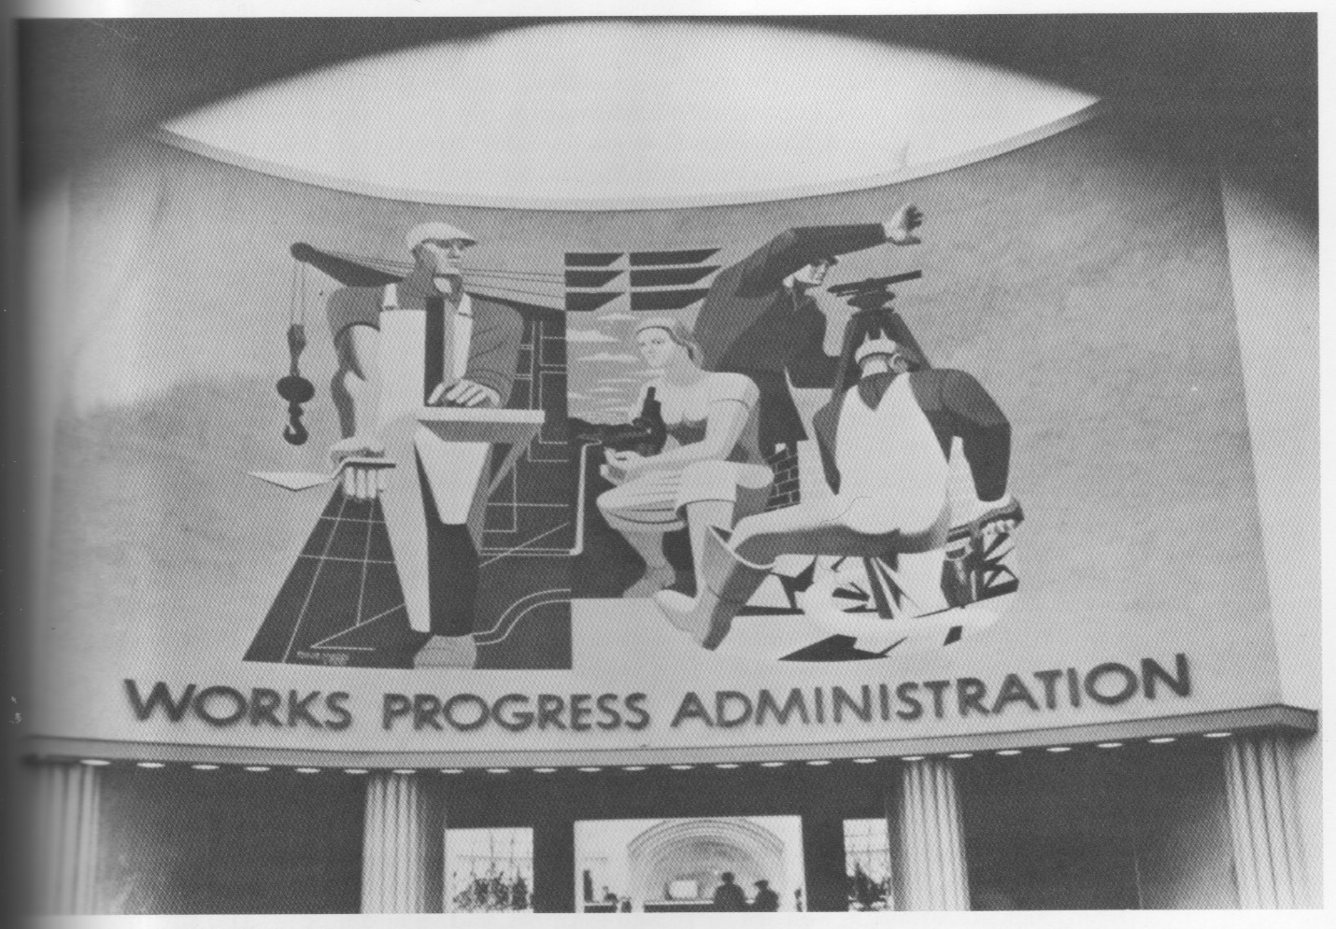
Art in Service of the State?:
Or, the Political Economy of New Deal Art (1933-1943) as Seen Through the Lens of State Theory
Cameron M. Weber
PhD student in economics and historical studies,
New School for Social Research
From the 1939-1940 Worlds Fair, Queens, NY

Slide 2
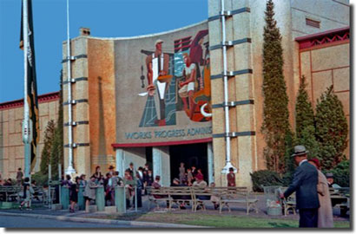
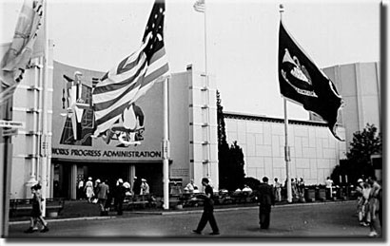
http://www.1939nyworldsfair.com/worlds_fair/wf_tour/zone-2/wpa.htm

Slide 3
The Political Economy of New Deal Art
Order of Presentation
New Deal as structural change not “reform”
State Theory and Propaganda
Findings from the Archives
Summation

Slide 4
The Political Economy of New Deal Art
New Deal as structural change not “reform”
Jonathon Harris (Federal Art and National Culture: the Politics of Identity in New Deal America 1995) claims,
Both the art and FDR’s speeches were “‘national-popular’ rhetoric supporting Roosevelt’s reformist policies”.
In the final analysis Harris finds that the New Deal served the interests of monopoly capitalism.
I propose that the New Deal served a self-interested state and that the change was radical, not “reformist”.

Slide 5
The Political Economy of New Deal Art
New Deal as structural change not “reform”
Fishback (New Palgrave Dictionary of Economics 2008) writes New Deal “created the most dramatic peacetime expansion of government in American economic history”.
US President’s Office of Management and Budget (2013) reports federal revenues as a percentage of the economy almost doubled between 1933 and 1940. In other words, the size of the federal government almost doubled during the New Deal.

Slide 6
The Political Economy of New Deal Art
New Deal as structural change not “reform”
Beito (From Mutual Aid to the Welfare State 2000) and Cohen (Making of a New Deal 1990) claim that the social welfare programs offered by the state in effect “crowded-out” the previously existing decentralized mutual aid.
Smith (“New Deal Order” 2008) proposes massive WPA public works projects also helped to acculturate a larger presence for the federal state into the daily lives of Americans.

Slide 7
The Political Economy of New Deal Art
New Deal as structural change not “reform”
Almost 25% of American families received income from the WPA (between 1% and 2% being artists on the WPA/Federal Art Project).
Expectations became that federal government would or should use relief monies to act as “employer-of last-resort” (Howard The WPA and Federal Relief Policy 1943, Foster and McChesney “A New New Deal Under Obama?” 2009).
In 1936 only 30% of the labor force was employed with private entities, the rest were in “public works and government service, the Works Progress Administration and relief” (Barber Designs within Disorder 1996).

Slide 8
The Political Economy of New Deal Art
New Deal as structural change not “reform”
First New Deal (“first 100 days” in 1933) focused on economic recovery.
Second New Deal (1935-1936) was social reform, created:
The WPA, the National Labor Relations Act, the Social Security Act (including Aid to Dependent Children), Federal Deposit Insurance, the Federal Housing Administration, and the Wealth Tax Act (the “soak the rich” tax). Federal minimum wage added in 1938.
All but the WPA have been the lasting legacies of the Roosevelt era, and represent the transition to the modern American state.

Slide 9
The Political Economy of New Deal Art
State Theory and Propaganda
Following Wagner (Fiscal Sociology and the Theory of Public Finance 2007), we define:
the “state” as that entity which has the monopoly power to tax.
“government” is the form that represents this state, be it constitutional democracy, absolute monarchy, theocracy, dictatorship, etc.

Slide 10
The Political Economy of New Deal Art
State Theory and Propaganda
It is known that totalitarian states attempt to use propaganda and censorship in the arts (Shostakovich Testimony 1979, Schivelbusch Three New Deals 2008, Matynia Performative Democracy 2009).
My work studies state propaganda in a democracy where the state must maintain its perceived legitimacy.
From Weber (Politics as a Vocation 1919) we learn of the state’s monopoly on violence, that in a democracy a state must maintain its legitimacy, and, that statists seek power and prestige.

Slide 11
The Political Economy of New Deal Art
State Theory and Propaganda
“Nowadays, in contrast, we must say that the state is the form of human community that (successfully) lays claim to the monopoly of legitimate physical violence within a particular territory – and this idea of ‘territory’ is an essential defining feature.”
“[T]he state represents a relationship in which people rule over other people. This relationship is based on the legitimate use of force (that is to say force that is perceived as legitimate).”
“Whoever is active in politics strives for power, either power as a means in the service of other goals, whether idealistic or selfish, or power ‘for its own sake,’ in other words so as to enjoy the feeling of prestige that it confers” (all emphasis in original).

Slide 12
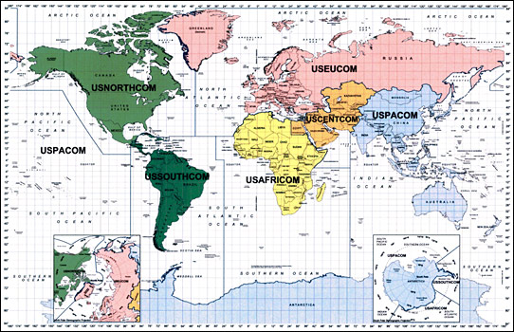
The Political Economy of New Deal Art
State Theory and Propaganda

Slide 13
The Political Economy of New Deal Art
State Theory and Propaganda
From de Jasay The State (1985),
There are two first principle ways to evaluate the state.
1) The state is an “inanimate tool, a machine” without ends, as only individuals have aspirational ends and the state is a tool manipulated by others for their own ends, or
2) “Merge the state and the people who run it, and consider the state as a live institution which behaves as if it has a will of its own and a single hierarchy of ends…”. Jasay chooses this latter analytical lens “because it looks the most fertile in plausible deductive consequences”. This is not to propose that the state and its representatives do not engage in what we might conceive as benevolence, only that it is not scientific to hypothesize that this is the state’s only motive.

Slide 14
The Political Economy of New Deal Art
State Theory and Propaganda
Following Weber (1919) de Jasay writes,
“Instead of saying, tautologically, that the rational state pursues its interests and maximizes its ends, whatever they are, I propose to adopt, as a criterion of rationality, that it seeks to maximize its discretionary power.”
However in doing so the state must “implant in the public consciousness a certain sense of the state’s legitimacy”.

Slide 15
The Political Economy of New Deal Art
State Theory and Propaganda
Schivelbusch’s Three New Deals (2006) provides our working definition of propaganda,
“Propaganda is the means by which charismatic leadership, circumventing intermediary social and political institutions like parliaments, parties and interest groups, gains direct hold upon the masses”.
A self-interested state in a democracy then uses propaganda to seek an increase in discretionary power while at the same time understanding that it needs to maintain its legitimacy with the “masses”.

Slide 16
The Political Economy of New Deal Art
State Theory and Propaganda
We adapt the Fichte Triangles from Alinsky Rules for Radicals (1971). A social problem (fear) is answered with a state solution (hope). In the next moment there is an increase in state power (bringing progress).

Slide 17
The Political Economy of New Deal Art
State Theory and Propaganda
If we find that if the state uses fear and hope (emotion being more successful at propaganda than reason – Rauth etal. “Psychology of Propaganda” 1940) and progress in its art, we can call this art statism.

Slide 18
The Political Economy of New Deal Art
Findings from the Archives, the Social Security mural
From the Stephen Lee Taller Ben Shahn Archive, Harvard University.
The case is Shahn’s proposal for a mural in the Social Security Building in Washington, DC in 1940.
(There were 4,000 murals installed in public buildings during the New Deal, Park and Markowitz New Deal for Art 1977.)

Slide 19
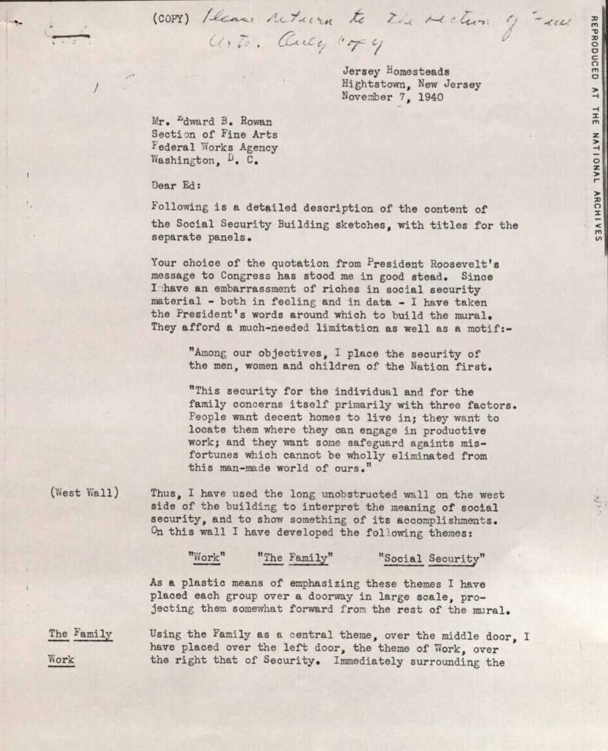
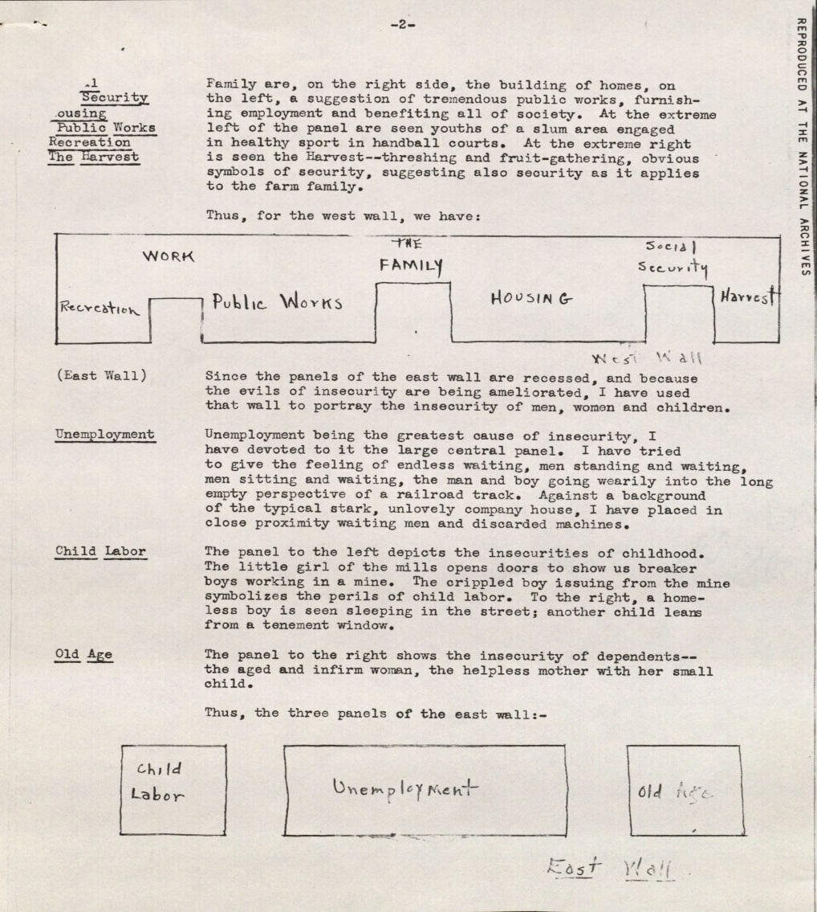
The Political Economy of New Deal Art
Findings from the Archives, the Social Security mural

Slide 20
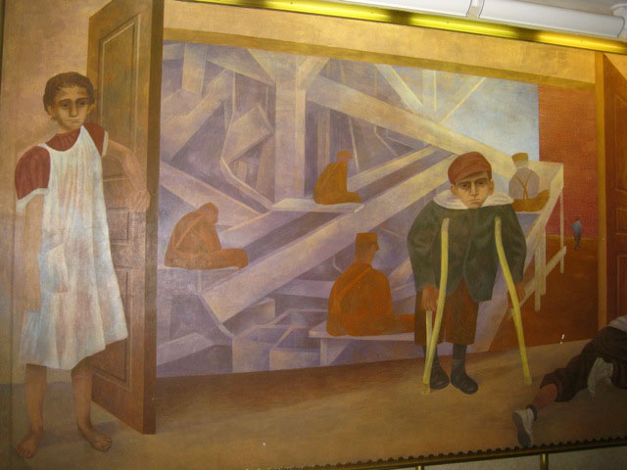
The Political Economy of New Deal Art
Findings from the Archives, the Social Security mural
Social Realism:
“A very broad term for painting (or literature or other art) that comments on contemporary social, political, or economic
conditions.” Oxford Dictionary Of Art and Artists.

Slide 21
The Political Economy of New Deal Art
Findings from the Archives, the New Jersey Homesteads mural
From the Smithsonian Archives of American Art, Washington, DC; Ben Shahn papers.
The case is Shahn’s mural in the Jersey Homestead Resettlement Project in Roosevelt, New Jersey, 1936-1938.
(The New Deal resettled people from more than 10 million “substandard” acres in the dustbowl, Barber 1996.)

Slide 22
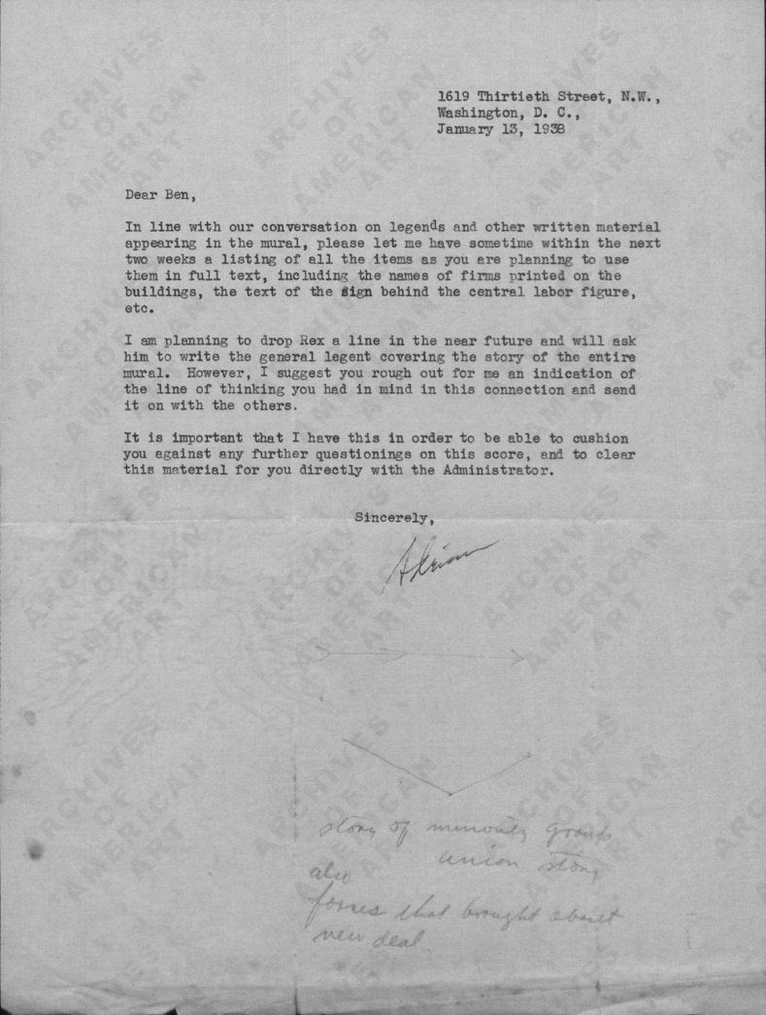
The Political Economy of New Deal Art
Findings from the Archives, the New Jersey Homesteads mural

Slide 23
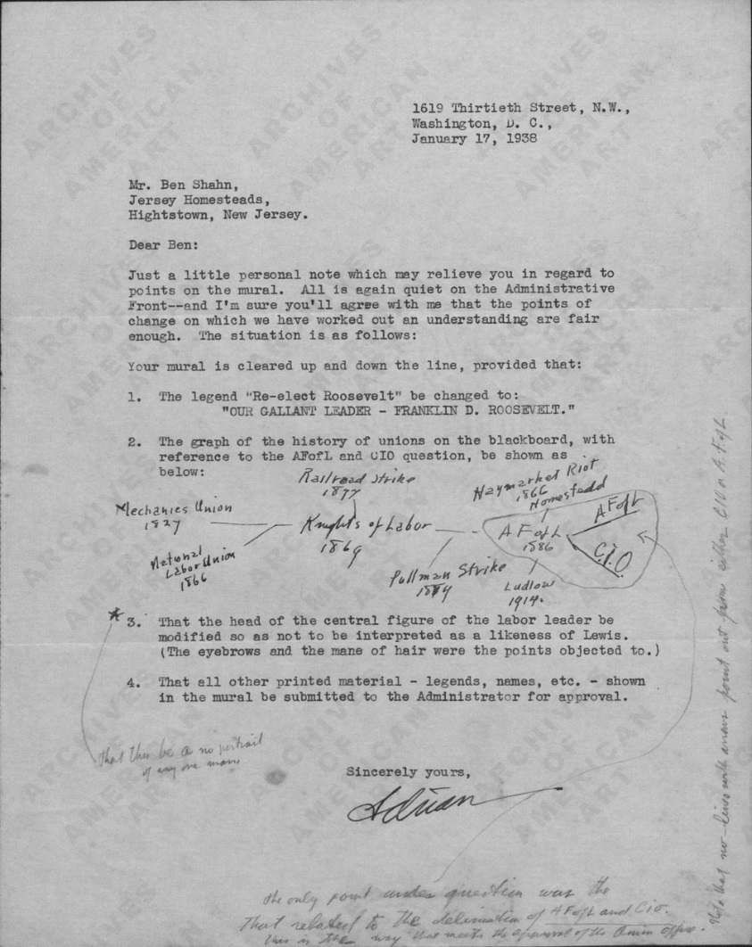
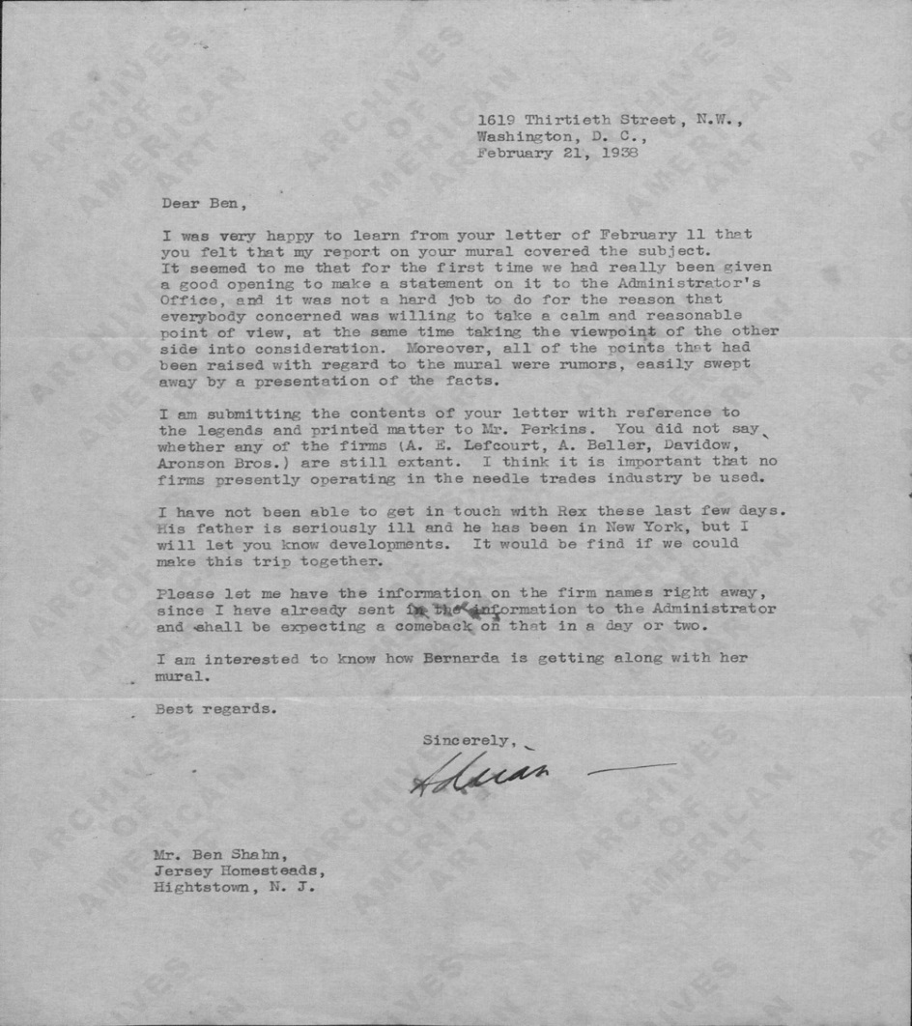
The Political Economy of New Deal Art
Findings from the Archives, the New Jersey Homesteads mural

Slide 24
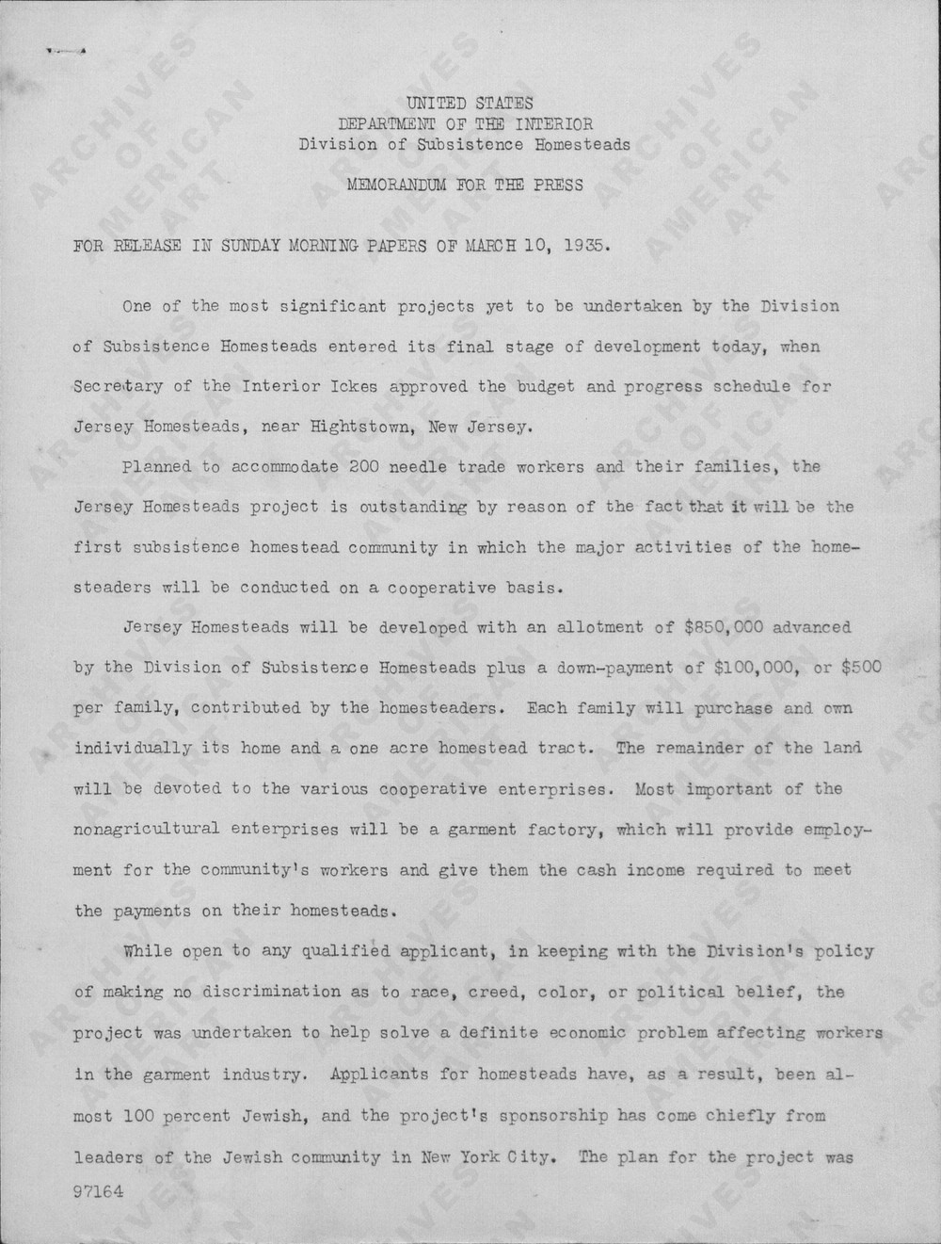
The Political Economy of New Deal Art
Findings from the Archives, the New Jersey Homesteads mural

Slide 25
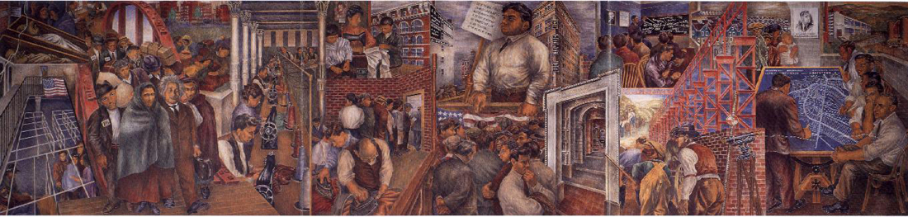
The Political Economy of New Deal Art
Findings from the Archives, the New Jersey Homesteads mural
http://music.columbia.edu/roosevelt/pop_mural.html . “The three panels of this 12 x 45 foot fresco mural depict the history of Roosevelt, from the eastern European origins of its Jewish residents and arrival at Ellis Island to the planning of their cooperative community. As the mural dramatizes, theirs was the story of escape from dark
tenements and sweatshops in the city to simple but light-filled homes, and a cooperative garment-factory, store, and farm in the country. Early supporters of the community, Albert Einstein and the artist Raphael Soyer, are depicted in the mural along with many of the original residents of the town.”

Slide 26
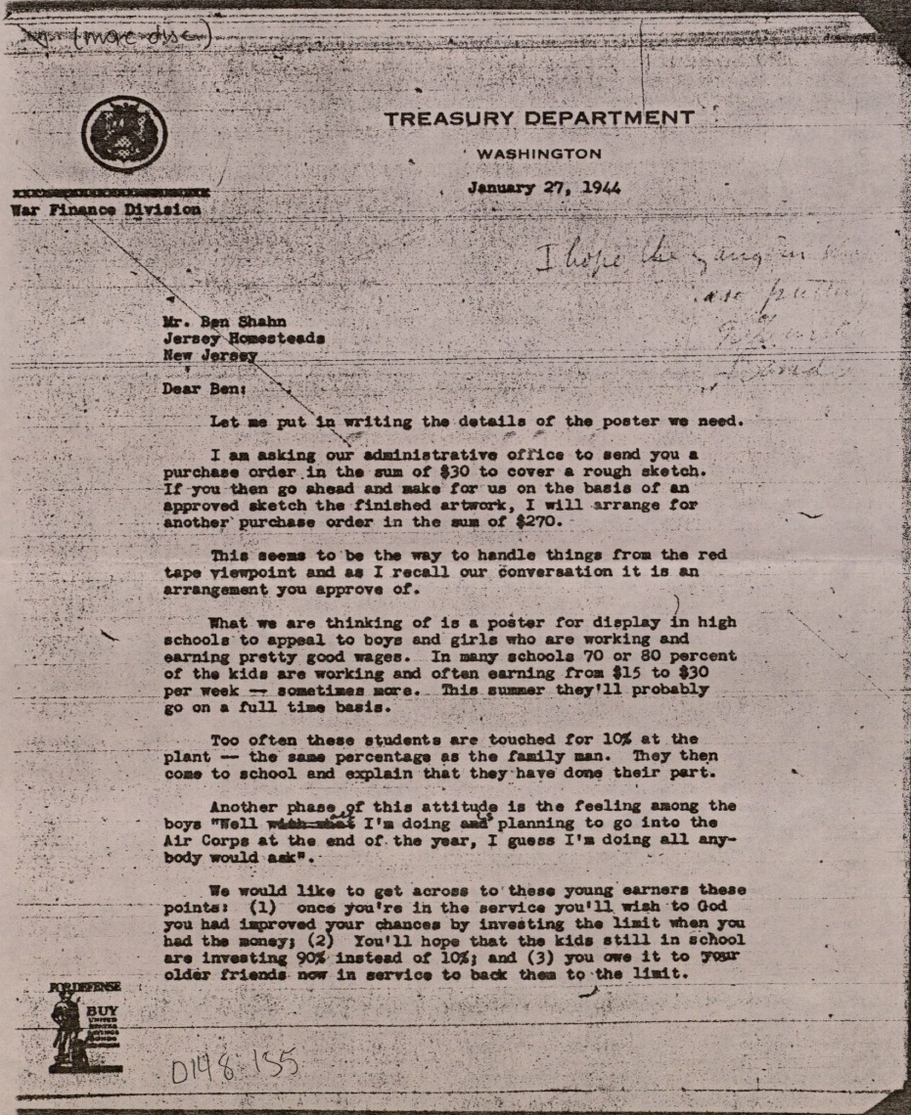
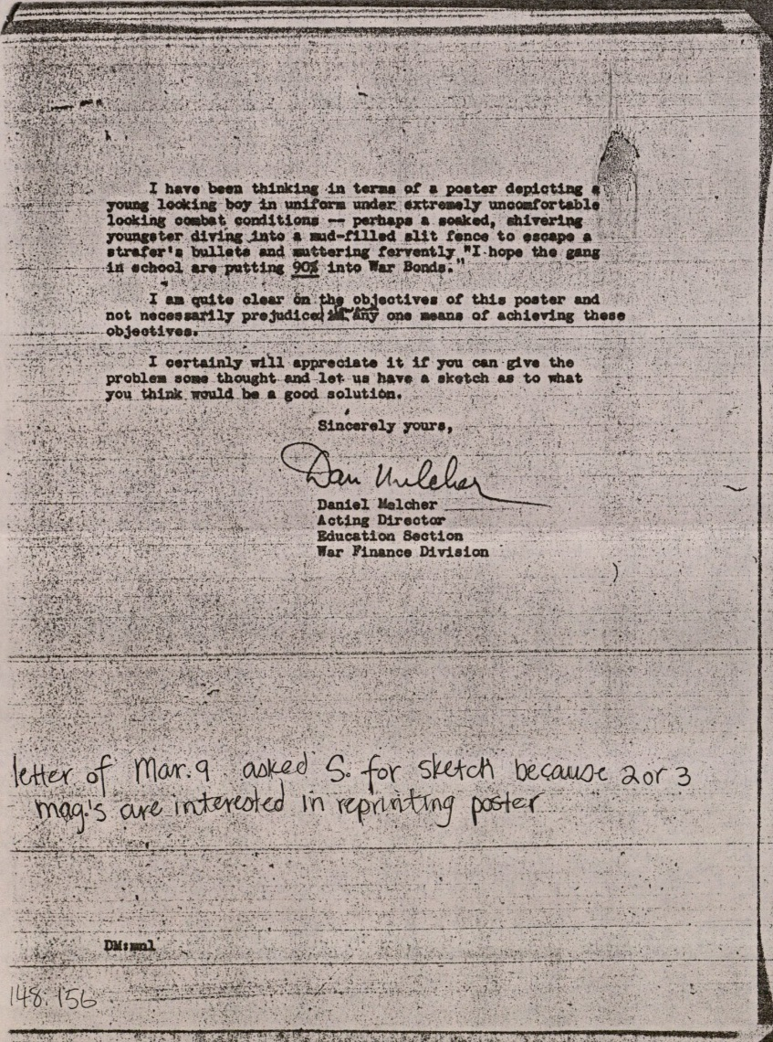
The Political Economy of New Deal Art
Findings from the Archives, War Finance

Slide 27
The Political Economy of New Deal Art
Summation
Carl Menger, Investigations into the Method of the Social Sciences (1871).
“But in this line of argument there are a number of fundamental errors. We admit quite unreservedly that real human phenomena are not strictly typical. We admit that just for this reason, and also as a result of the freedom of the human will – and we, of course, have no intention of denying this as a practical category – empirical laws of absolute strictness are out of the question in the realm of the phenomena of human activity” (emphasis in the original).
To say that some of the art produced in the New Deal is art statism is not to say that all art financed by a state is necessary propaganda.

Slide 28
The Political Economy of New Deal Art
The 1936 Museum of Modern Art Federal Art Project Show
http://www.artic.edu/sites/default/files/libraries/pubs/1937/AIC1937NewHrznAmArt_comb.pdf

