Slide 1
Alliance Economics and US Military Presence Overseas
(Note Title Change, now submitted to Journal of Peace and Defence Economics)
Cameron M. Weber
cameroneconomics.com

Slide 2
Alliance Economics and U.S. Military Presence Overseas
Overview of Presentation
a) Thesis Statement
b) Literature Review and Theoretical Underpinnings
c) US Military Presence as Global Commons
d) Empirics and Defense “Burden”
e) Conclusion

Slide 3
Alliance Economics and U.S. Military Presence Overseas
Thesis Statement
The US spends more on the military than the next 10 largest allies combined.
The US defence burden is twice that of the allied nation with the next largest defence burden (5% of national income versus 2.5% for S. Korea).
This paper claims US allies are “free-riding” on the US tax-payer and proposes that the US charges allied nation’s a “user fee” based on US military presence in-country. This approach will force allied nations to reveal and rationalize defence expenditures with a “make or buy” decision.

Slide 4
Alliance Economics and U.S. Military Presence Overseas
Literature Review and Theoretical Underpinnings of Argument
Paradigmatic article Olson and Zeckhauser (1966) find national defence is a public good, and, that larger members of an alliance pay a larger portion of a shared deterrence.
Sandler and Hartley (2001) call this disproportionality the “exploitation hypothesis”.
Gupta (2012) finds nation-state ‘preferences’ for shared deterrence are heterogeneous and unrevealed.
Duncombe (2011) finds that the militarization of culture in the West (read the ‘War on Poverty’, the ‘War on Drugs’, the ‘War on Terror’) foretells an increasingly opposed Other against which violence is facilitated.

Slide 5
Alliance Economics and U.S. Military Presence Overseas
Literature Review and Theoretical Underpinnings of Argument
These findings I believe imply that free-riding can be reduced, preferences revealed, allocative efficiency improved and aggression reduced, through introducing competition into our historically-contingent status quo defence in the allied West.

Slide 6
Alliance Economics and U.S. Military Presence Overseas
US Military Presence as Global Commons
Economics of national defence alliances as private, public or club good is unresolved (Sandler and Hartley 2001, Engerer 2011).
Some view defence alliances as “club goods” with ability to exclude free-riders. NATO is most common example.
However, US alliances are ever-changing and historically-contingent (viz. US support for Osama Bin Laden against USSR in Afghanistan, current alliance with Pakistan in War on Terror and US support for Sadam Hussein in the Iraq-Iran war) so therefore in long-term excludability assumption necessary for club good seems inappropriate.

Slide 7
Alliance Economics and U.S. Military Presence Overseas
US Military Presence as Global Commons
I find that US military presence is a shared “global commons good”, which cannot be divisible as a private or club good.
This can be seen in the actually-existing US global military presence.
This research does not question the goals (ends) of US national defence policy only the means.

Slide 8
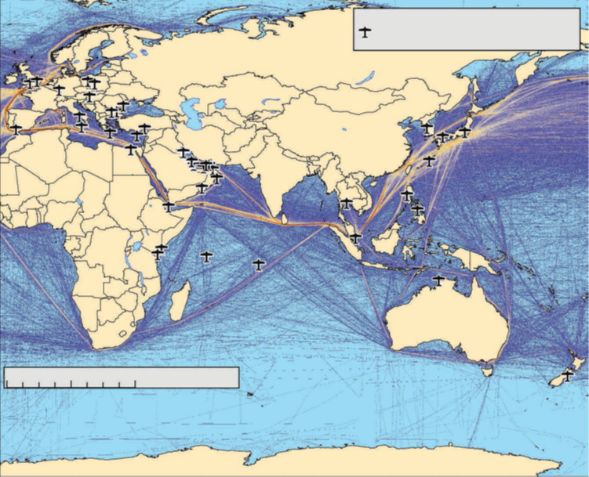
Alliance Economics and U.S. Military Presence Overseas
US Military Presence as Global Commons
US Overseas Military Presence and Global Shipping Routes by Volume (Source: RAND 2012)

Slide 9
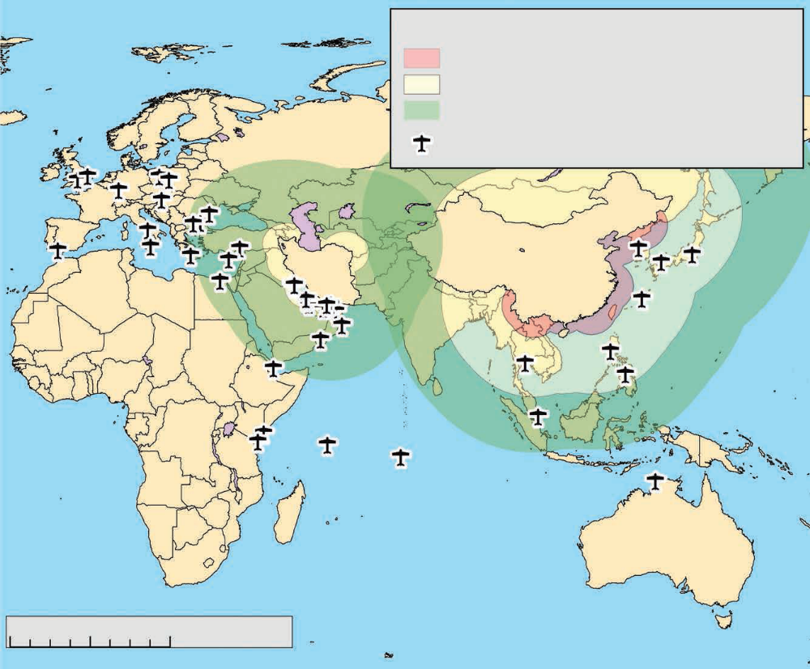
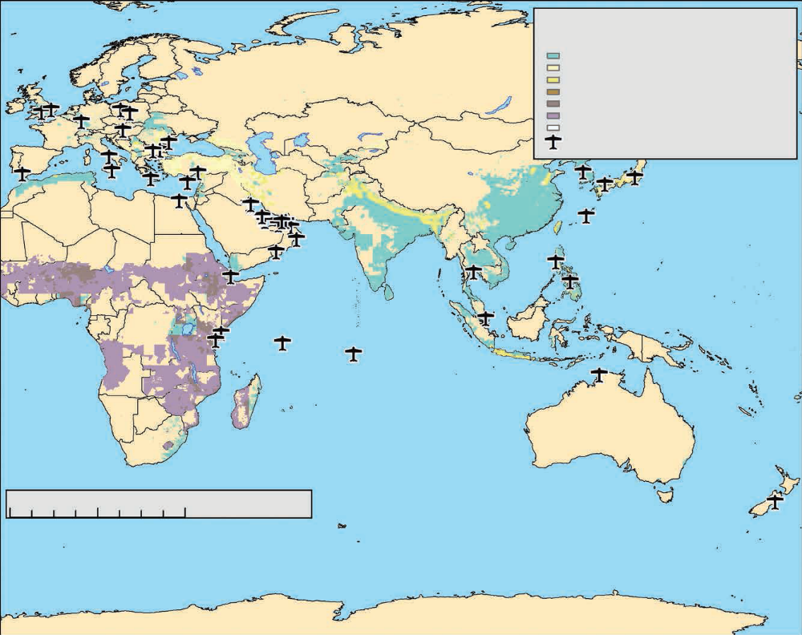
Alliance Economics and U.S. Military Presence Overseas
US Military Presence as Global Commons
US Overseas Military Presence and
Iranian and Chinese Missile Threats
(Source: RAND 2012)
US Overseas Military Presence and Risk of Mortality by Disaster Type – Hydrologic, Seismic, and Drought
(Source: RAND 2012)

Slide 10
Alliance Economics and U.S. Military Presence Overseas
Empirics and Defence “Burden”
The most common example of a “commons good” is over-fishing in the oceans. Engerer 2011 writes,
This is also circumscribed by the notion of ‘the tragedy of the commons’. One solution to overcome this situation is a regulation that determines the volume that an individual can withdraw from the common-pool resource within a certain period of time. A regulatory authority must ensure that regulation is really enforced (page 138, emphasis added).
Due to free-riding by allies the US has the incentive to act as this “regulatory authority”.

Slide 11
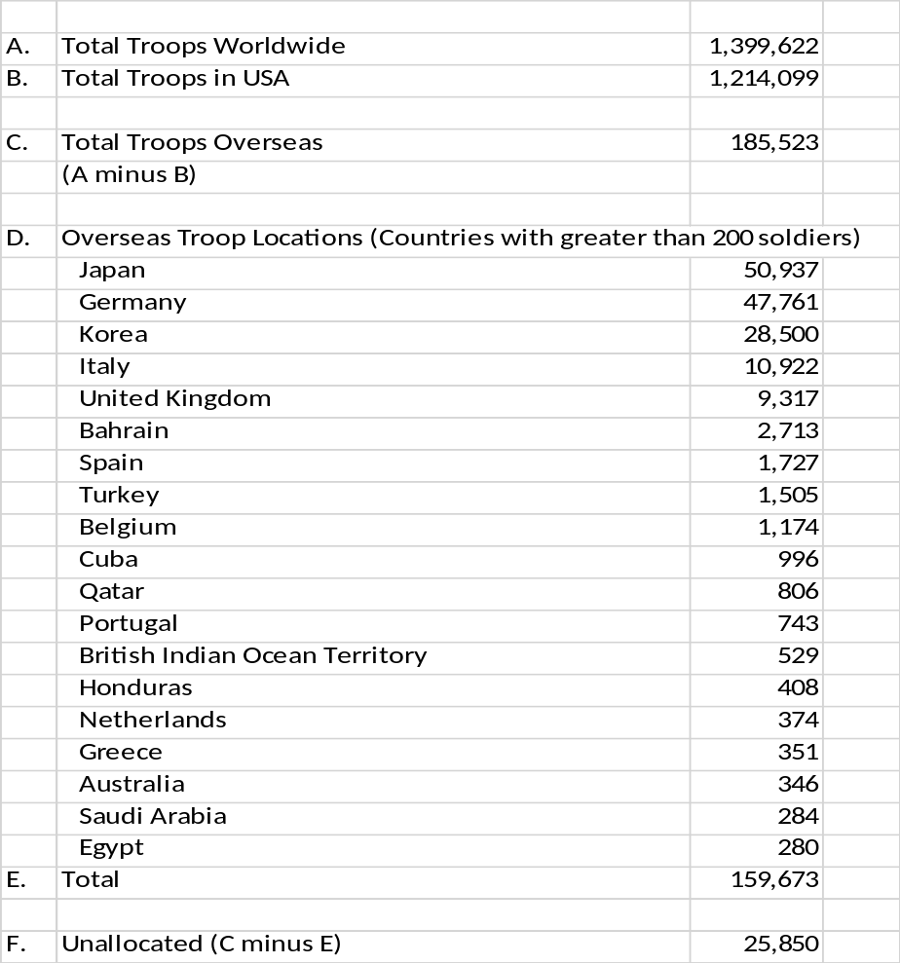
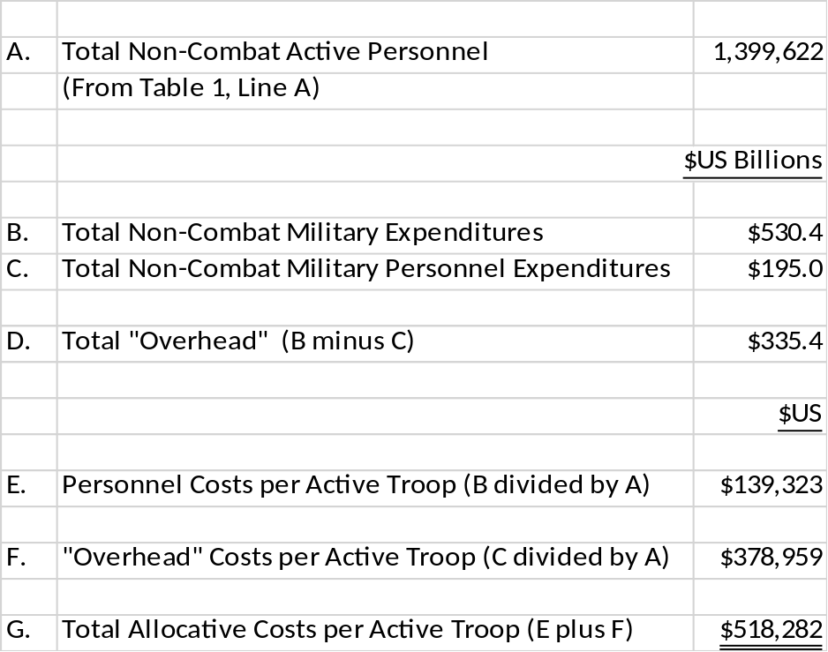
Alliance Economics and U.S. Military Presence Overseas
Empirics and Defence “Burden”
Non-Combat Active U.S. Military Personnel (FY2012)
Cost Allocation for “User Fee”
Source: US OMB 2013, US DoD 2013, calculations by author
Source: US DMDC and US Senate 2013

Slide 12
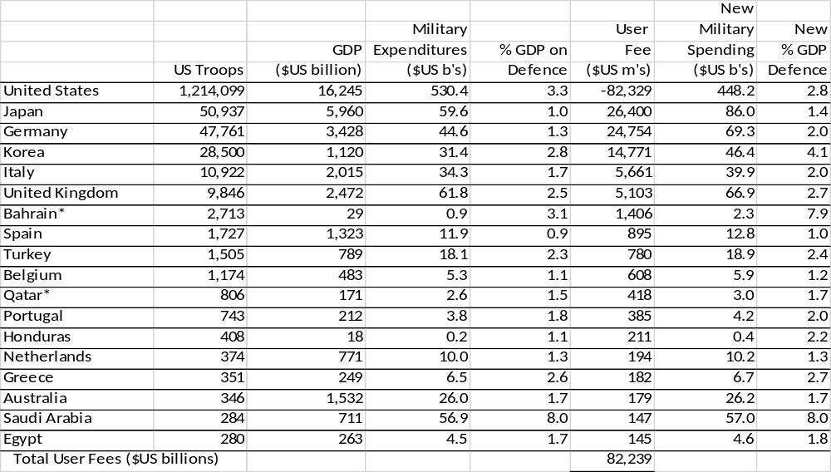
Alliance Economics and U.S. Military Presence Overseas
Empirics and Defence “Burden”
Data and Cost Allocation, Allied Nations (2012)
Source: US DMDC, World Bank, US OMB 2013, calculations by author

Slide 13
Alliance Economics and U.S. Military Presence Overseas
Conclusion
US military non-combat presence overseas is a global commons good which is over-consumed by U.S. allies as shown in actually-existing defence burdens.
Cost-allocating on a per soldier basis and charging allies this “user fee” would improve allocative efficiency as host-countries face a “make or buy” decision for their national defence, forcing the revelation and rationalization of national defence preferences.
Reform as proposed might also reduce militaristic rent-seeking and therefore increase value-creating entrepreneurship (Anderson etal. 2012).

Slide 14
Alliance Economics and U.S. Military Presence Overseas
Works Cited in this Presentation
Anderson, W.J., S.A. Kjar and J.D. Yohe. 2012. “War and the Austrian School: Modern Austrian Economists Take on Aggressive Wars.” The Economics of Peace and Security Journal. Vol. 7, No. 1, pp. 30-37.
Duncombe, C. 2011. “Foreign Policy and the Politics of Representation: the West and its Others.” Global Change, Peace and Security. Vol. 23, No. 1, pp. 31-46.
Engerer, H. 2011. “Security as a Public, Private or Club: Some Fundamental Considerations.” Defence and Peace Economics Vol. 22, No. 2, pp. 135-145.
Gupta, R. 2012. “Designing Institutions for Global Security.” The Economics of Peace and Security Journal. Vol. 7, No. 2, pp. 25-32.
Olson, M and R. Zeckhauser. 1966. “An Economic Theory of Alliances.” Review of Economics and Statistics. Vol. 48, pp. 266-279.
Preble, C.A. 2013. “The Costs of Our Overseas Military Presence.” Cato Institute. http://www.cato.org/blog/costs-our-overseas-military-presence. [accessed 4 February 2014].

Slide 15
Alliance Economics and U.S. Military Presence Overseas
Works Cited in this Presentation (cont.)
RAND Corporation. 2012. “U.S. Overseas Military Presence: What Are the Strategic Choices?” http://www.rand.org/content/dam/rand/pubs/monographs/2012/RAND_MG1211.pdf [accessed 4 February 2014].
US President’s Office of Management and Budget (US OMB). 2013. Fiscal Year 2014 Budget of the U.S. Government. http://www.whitehouse.gov/sites/default/files/omb/budget/fy2014/assets/budget.pdf [accessed 4 February 2014].
US Senate. 2013. “Inquiry into U.S. Costs and Allied Contributions to Support the U.S. Military Presence Overseas” www.levin.senate.gov/download/sasc-overseas-basing-report [accessed 4 February 2014].‎
US Department of Defence (US DoD). 2013b. “Defence Budget Priorities and Choices Fiscal Year 2014.” http://www.defence.gov/pubs/DefenceBudgetPrioritiesChoicesFiscalYear2014.pdf [7 March 2014].
US Defence Manpower Data Center (US DMDC). www.dmdc.osd.mil/appj/dwp/reports.do?category=reports&subCat=milActDutReg [accessed 8 February 2014].
World Bank, Military expenditures (% of GDP). http://data.worldbank.org/indicator/MS.MIL.XPND.GD.ZS [accessed 2 September 2013].

